Slide 1
Chronic Disease Friendly Policies and Practices
*** Your Name and Position***
Notes:
Good (morning, afternoon, evening); thank you for giving me the opportunity to speak with you today. My name is _____________ and I am the school nurse for __________________. I am here today to talk with you about an important health issue that has a significant impact on our school system- asthma.
My goal today is to help you to learn more about our school(‘s, district’s) policies and practices regarding asthma, and to make you more aware of some of the additional steps that the school (district) can take to combat this disease.
In assessing the policies and practices, I used a checklist provided by the Montana Asthma Control Program to assist me in addressing different areas of interest.
I will go through different policies and practices related to school health services and coordination, as well as polices and practices related to the school environment.
As we are going through this presentation, please do not hesitate to ask me questions if you need clarification at any time.

Slide 2
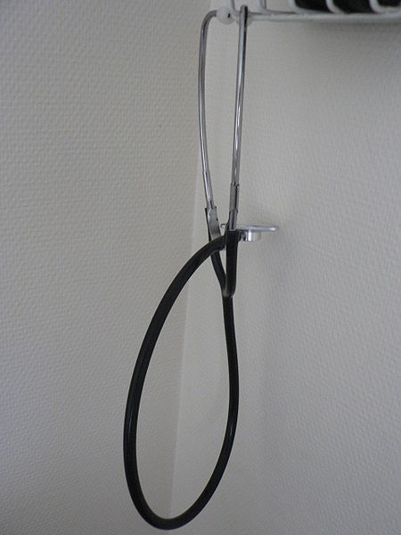
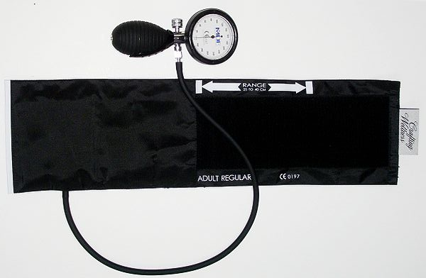
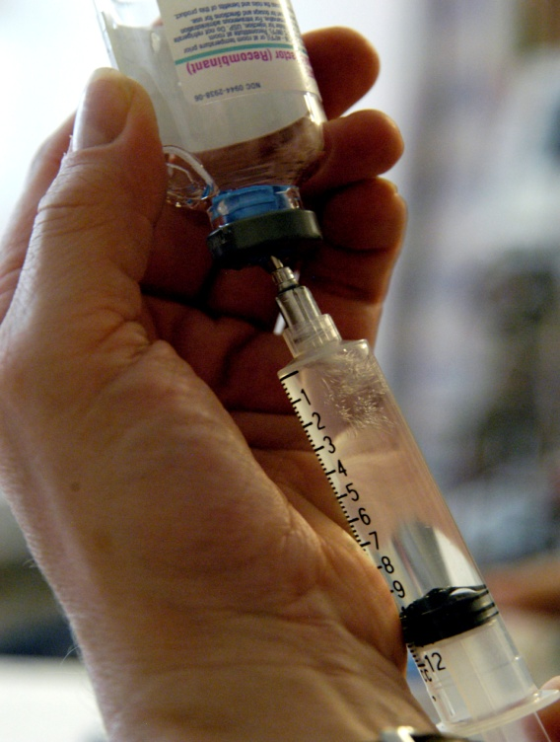
School Health Services and Coordination
Notes:
First, I will address policies and practices related to school health services and coordination.

Slide 3
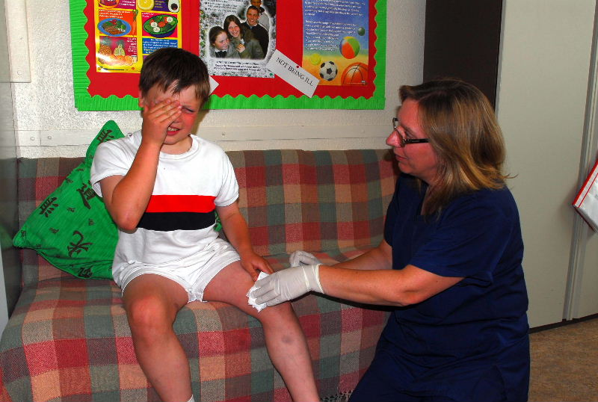
School Nurse Ratio
The Centers for Disease Control and Prevention (CDC) recommends that there be at least one full-time school nurse for every 750 students
Notes:
The CDC recommends at least one full-time nurse for every 750 students.
The recommendation is meant to ensure that students’ health issues can be addressed in a timely manner.

Slide 4
How is Our School Doing?
Notes:
(Indicate on the slide whether or not your school/school district meets the recommended ratio and what the ratio of students to nurse is in your school/school district.)
(If you don’t meet the recommendation, you can recommend increasing funding for school nurse support.)

Slide 5

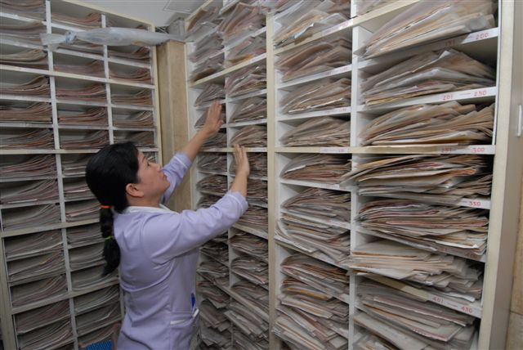
Identification of Students with Asthma
Montana law requires that all students who self-carry asthma and severe allergy medication fill out the required paperwork annually (MCA 20-5-420)
  All students with chronic health conditions should be identified annually in order to ensure school safety
Important health information should be passed on to relevant school staff
Notes:
Those students who self-carry medication for asthma and severe allergy need to have paperwork filled out every year.
In addition, all students who have ongoing health concerns need to be identified annually, so that critical health information can be passed along to relevant school staff.

Slide 6
How is Our School Doing?
Notes:
(Indicate on the slide whether or not students are being identified and the health information passed along to relevant staff.)
(If the recommendation is not being met, you can recommend the health history form found on page 27 of the “Creating Asthma Friendly Schools in Montana” resource guide as a way to identify students with chronic health conditions. If there is not paperwork for students who self-carry asthma or allergy medication, point to the form on page 7 of the resource guide.)

Slide 7

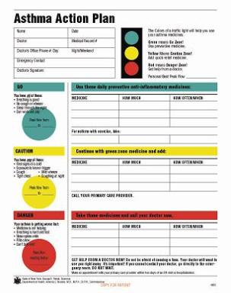
Written Treatment Plans
Written treatment plans should be prepared for all students with chronic health conditions
  This includes having asthma action plans for all students with asthma
  The National Asthma Education and Prevention Program encourages students to provide their school with an asthma action plan
Notes:
To ensure that school staff know what steps to take if a student with a chronic health condition is having difficulties, written treatment plans should be prepared.
Asthma action plans need to be in place for all students with asthma; this enables the students and school staff to know in advance the steps that need to be taken when an asthma flare-up occurs.

Slide 8
How is Our School Doing?
Notes:
(Indicate on the slide whether or not written treatment plans and asthma action plans are prepared and readily available.)
(You could also consider showing a sample of an asthma action plan to your audience.)

Slide 9
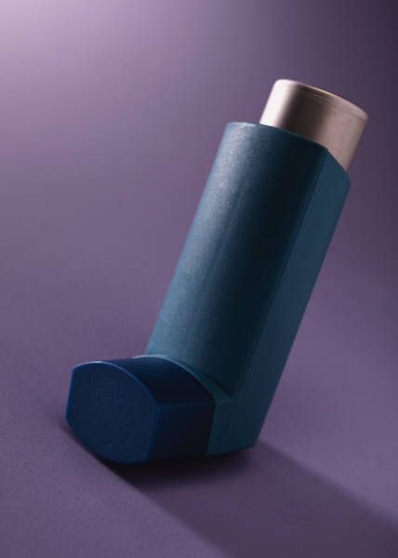

Self-Carry Law and Backup Medications
MCA 20-5-420 states that: “(a) school…shall permit the possession or self-administration of medication, as prescribed, by a pupil with asthma, severe allergies, or anaphylaxis…”
Additionally, the law states that: “asthma, severe allergy, or anaphylaxis medication may be kept by the pupil and backup medication must be kept at a pupil's school in a predetermined location or locations to which the pupil has access in the event of an asthma, severe allergy, or anaphylaxis emergency.”
Notes:
Montana law provides that students, with the proper paperwork completed, may self-carry and self-administer their own asthma medication.
The law also allows for backup medication to be kept at school.
The exact wording from the law is on the slide.
Ensuring that this law is followed is critical for enabling easy access to rescue medication inhalers; consequently, the need for emergency medical care can be prevented.

Slide 10
How is Our School Doing?
Notes:
(Indicate on the slide if students are allowed to self-carry their asthma and allergy medications, as well as whether or not all school/school district staff have been informed of the self-carry law.)
(Indicate whether or not backup medication is stored at the school. Consider suggesting a good place where backup medication could be stored.)

Slide 11
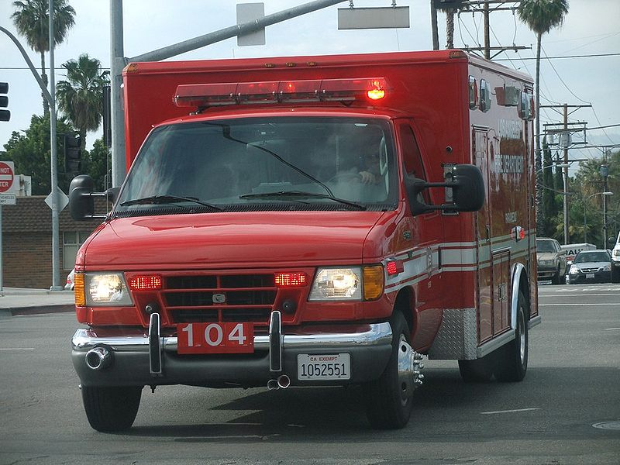
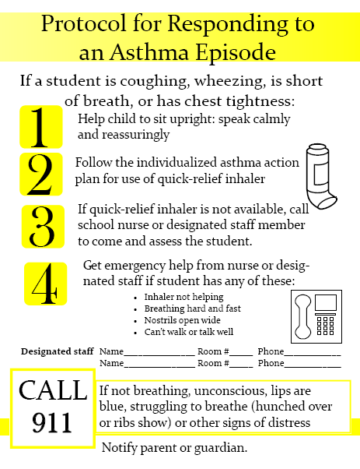
Emergency Health Procedures
School wide protocols need to be in place for handling emergency medical situations, including asthma attacks
Staff should be educated on these protocols and know where they can quickly find the protocols in an emergency.
Notes:
The school (school district) should have in place a protocol for responding to asthma attacks.
School staff need to be made aware of this protocol, and the protocol should be widely posted around the school.

Slide 12
How is Our School Doing?
Notes:
(Indicate on the slide if school wide protocols are in place for responding to emergency medical situations, including asthma attacks. Also indicate if the protocol is posted widely around the school.)
(If appropriate emergency protocols have not been put into place, encourage use of “Emergency Guidelines for Schools” [available from the Montana Department of Public Health and Human Services], and/or “First Aid Guidelines for Schools” [available from the Montana School Nurses Association].)

Slide 13

Staff Training
School staff need to receive regular training on common health conditions, including asthma
  Approximately one out of every fifteen Montana children has asthma.
Notes:
In order to enable school staff to be informed of asthma, regular training is necessary.
This is especially critical since asthma is so common; around 10% of Montana children have asthma.

Slide 14
How is Our School Doing?
Notes:
(Indicate on the slide if regular training is provided on health conditions, including asthma.)
(If regular training is not provided, consider recommending that the administration contact the Montana Department of Public Health and Human Services for trainings on diabetes, emergency response, or asthma.)
(Also recommend that the school use you [the school nurse] as a resource, as well as suggest other local resources.)

Slide 15
Other Health Services Policies
***Add information about other relevant policies related to school health services and coordination***

Slide 16
How is Our School Doing?

Slide 17

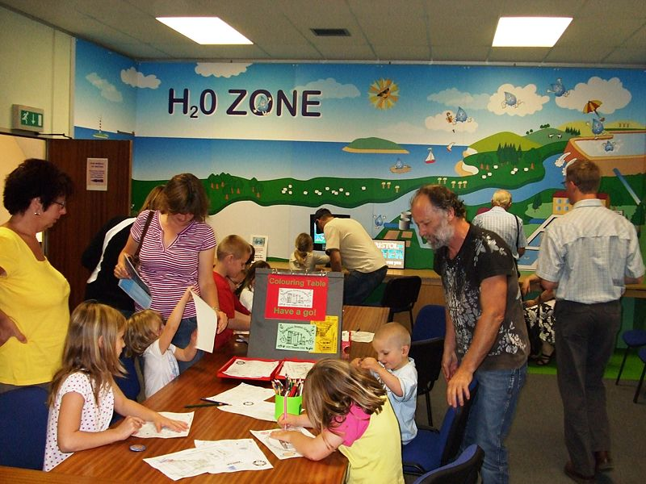

School Environment
The school and school site must be free of objects or conditions which create unreasonable or unnecessary dangers to health or safety.
Science, Industrial Arts, and Art Laboratory Safety
Schools containing science labs, industrial arts classrooms or buildings, and art labs that use and store hazardous chemicals must maintain a Chemical Hygiene Plan (CHP) and designate a Chemical Hygiene Officer (dCHO) in accordance with the requirements of the Occupational Safety and Health Administration (OSHA) Occupational Exposure to Hazardous Chemicals in Laboratories standard 29 CFR 1910.1450.
Safety Data Sheets (SDS) for all materials in science labs, industrial arts classrooms or buildings, art labs, and lab storage rooms will be stored in those rooms and be accessible at all times. The SDS must also be kept in a secure, remote site outside of the science labs, industrial arts classroom or buildings, art labs, and lab storage rooms.
Notes:
Next, I am going to address policies and practices related to the school environment.

Slide 18
School Environment Cont.
First Aid
First aid kits and AEDs must be provided and stored in accessible locations that are easily identifiable to staff and trained personnel.
Playgrounds
Playground and school yards must be inspected every month by the facility manager or other school personnel and the inspection must be recorded and records kept on the school site. Playground inspection results must be made available for review by the local health authority or the department upon request.
Periodic maintenance and repair must be performed on playground equipment according to the manufacturer's specifications.
Water Quality
Schools must regularly sample all water fountains and sinks used for food preparation. All other potential human consumption fixtures (HCF) must be sampled, unless the school or school district submits a testing plan to the DEQ to test a representative sample of potential HCFs in the school. All samples must be analyzed by a Montana certified lab using EPA-approved standard drinking water methods for the detection and quantification of lead.
All schools must create and implement a water flushing program unless the school meets waiver requirements established by DEQ.

Slide 19
School Environment Cont.
Other
Schools must provide reasonable accommodations for students and staff on the school campus to express breast milk, breastfeed an infant child, or address other needs related to breastfeeding.
Schools must have and follow written policies and procedures regarding the storage, administration, and lawful disposal of prescription, nonprescription, and over-the-counter medication.
To reduce the spread of animal-borne diseases, livestock and poultry must be located more than 50 feet from food service areas, offices, or classrooms except those offices and classrooms associated with animal husbandry activities or other demonstrations as approved by the school administration.

Slide 20
How is Our School Doing?

Slide 21



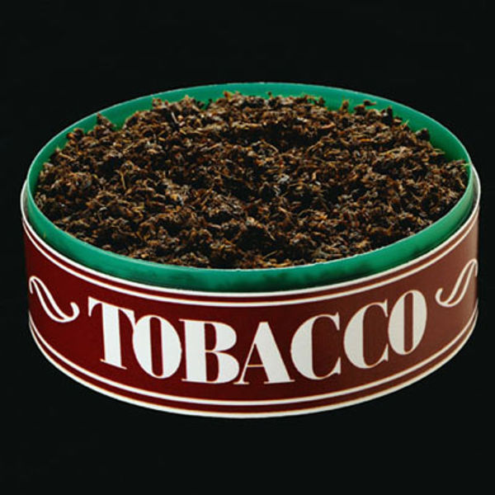
Tobacco/E-Cigarettes
Tobacco products and E-cigarettes should be completely eliminated from the school environment.
  Tobacco smoke is a potent asthma trigger
  Montana law prohibits tobacco use on school property.
  Montana law requires No Tobacco Use signage at entry points throughout school buildings
INDEPTH (American Lung Association)
Intervention for Nicotine Dependence: Education, Prevention, Tobacco and Health (INDEPTH) is a new alternative to suspension or citation that helps schools and communities address the teen vaping problem in a more supportive way. INDEPTH is an interactive program that teaches students about nicotine dependence, establishing healthy alternatives and how to kick the unhealthy addiction that got them in trouble in the first place.
Notes:
Tobacco products and E-cigarettes should be eliminated completely from the school environment.
This will serve to reduce the risk of asthma attacks, but the elimination of tobacco use will reduce the risk of developing many other diseases as well.
Also, remember that tobacco use on public school property is prohibited by Montana law.
The INDEPTH program is an alternative to suspension programs that supports youth tobacco cessation.

Slide 22
How is Our School Doing?
Notes:
(Indicate on the slide if students are comprehensively protected from tobacco via all of the methods that are listed on the checklist.)
(You may also indicate that free signage is available from the Montana Department of Public Health and Human Services to assist schools in instituting comprehensive tobacco free school policies. An order form is available at: http://tobaccofree.mt.gov/signage.shtml.)

Slide 23
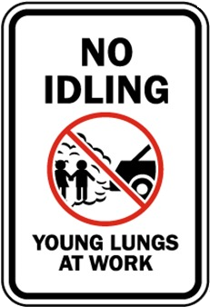

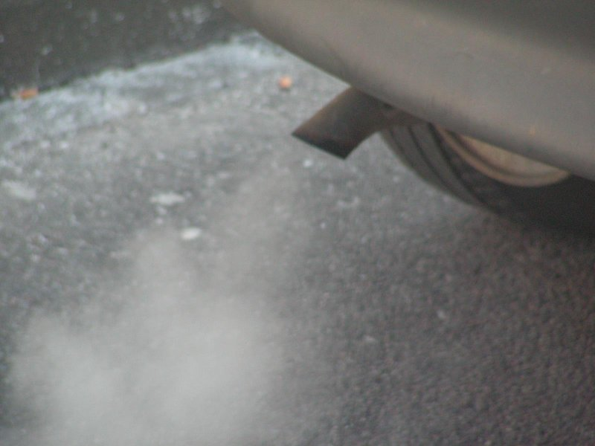
Vehicle Idling
Instituting a “No Idling” policy can improve air quality around the school
  These policies are supported by both the US Environmental Protection Agency and the MT Department of Environmental Quality
  In addition to reducing pollutants, reducing idling also has the potential to save fuel costs for the school district
Notes:
Exhaust from motor vehicles is a known asthma trigger.
Consequently, buses and other vehicles should be prohibited from idling near the school.
Reduced idling policies are endorsed by both the EPA and the Montana DEQ.
By reducing school bus idling, the school district may be able to save money on fuel costs as well.

Slide 24
How is Our School Doing?
Notes:
Indicate on the slide if the policies have been adopted and are being implemented at your school/school district, and if it appears to be successful.

Slide 25
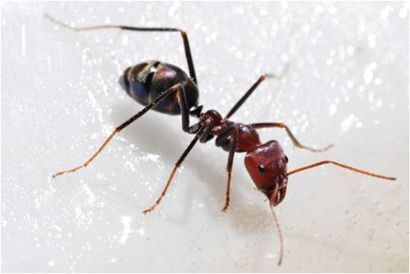
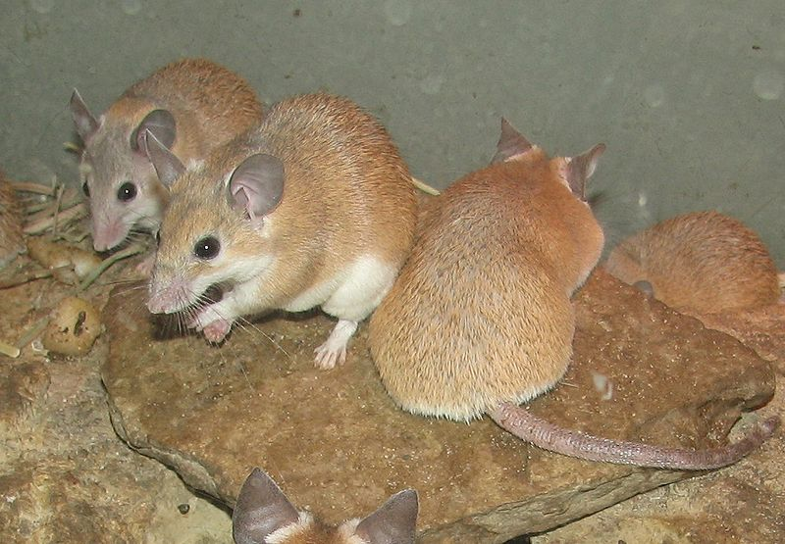
Pest Management
Montana law requires schools to maintain an Integrated Pest Management Program
Overuse of pesticides can trigger asthma
  Integrated pest management (IPM) techniques reduce or eliminate the use of pesticides while managing pest populations at an acceptable level
  The US Environmental Protection Agency recommends that schools use IPM
37.111.846
NOXIOUS PLANT AND ANIMAL CONTROL
Notes:
The use of pesticides, especially in large quantities, can trigger some students’ asthma.
Using integrated pest management (IPM) techniques can reduce, or even eliminate, the use of pesticides while also maintaining low levels of pests.
The use of IPM in schools is recommended by the EPA.

Slide 26
How is Our School Doing?
Notes:
(Indicate on the slide if IPM techniques are being utilized.)
(Indicate if pests are a problem in the school/school district, or if they are being adequately controlled.)
(If IPM techniques are not currently being utilized, consider referring the school board/administration to Linda Johns at the Montana Department of Agriculture [ljohns@mt.gov, 406-444-3676].)

Slide 27
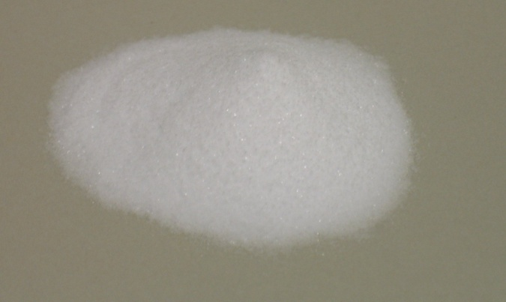


Cleaning Products
DPHHS School Administrative Rules recommend the use of green cleaning products to the extent possible in the school setting.
Use of “green” and less toxic cleaning products can improve indoor air quality
  Green cleaning products are encouraged by the US EPA and are less likely to irritate the airways of children with asthma
Notes:
Cleaning products can also trigger students’ asthma.
The use of less toxic cleaning products can result in less irritation of airways in children with asthma.
At times, cleaning can be accomplished with things as simple as baking soda, water, and vinegar.
Using green cleaning products in schools is encouraged by the EPA.

Slide 28
How is Our School Doing?
Notes:
(Indicate on the slide if “green” and less toxic chemicals are being used for cleaning.)
(If additional direction is required in this area, direct them to “The Quick & Easy Guide to Cleaning in Schools,” available at: http://www.healthyschoolscampaign.org/programs/gcs/.)

Slide 29
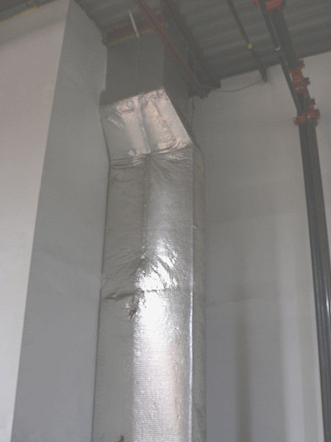
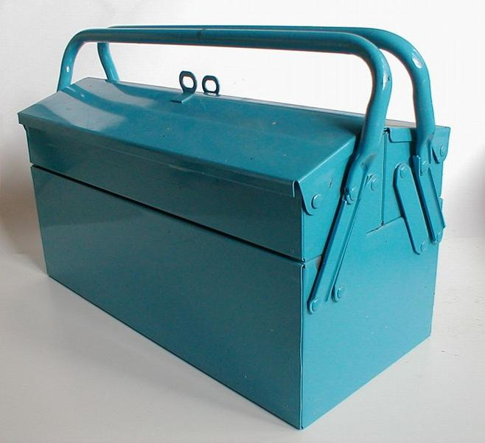
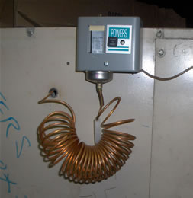
Heating, Ventilating, and Air Conditioning (HVAC) System
Montana law requires
  Regular inspection and maintenance of the Heating, Ventilating, and Air Conditioning (HVAC) system needs to be performed
  Annual internal Indoor Air Quality (IAQ) Inspections
dphhs.mt.gov/schoolhealth/schoolrules/
Notes:
In order to ensure optimum indoor air quality, the Heating, Ventilating, and Air Conditioning (HVAC) system needs to be regularly inspected and maintained.
A poorly maintained HVAC system will not provide adequate ventilation, potentially enabling airborne asthma triggers to accumulate.

Slide 30
How is Our School Doing?
Notes:
(Indicate on the slide whether or not the HVAC system is inspected and maintained on a regular basis.)
(If not, you can recommend the “IAQ Tools for Schools” Video Collection DVD, available at: http://www.epa.gov/iaq/schools/actionkit.html#dvd. This DVD contains a film on how to operate and maintain school ventilation systems.)

Slide 31
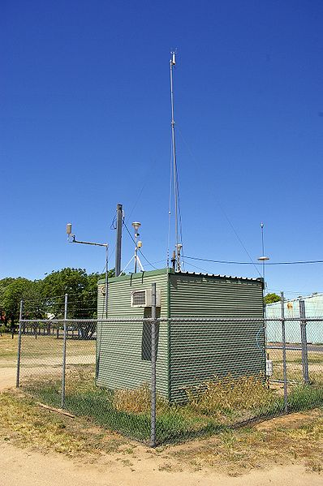
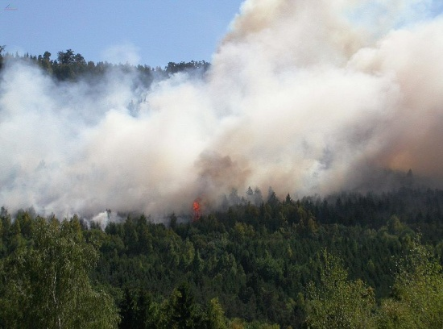
Indoor/Outdoor Air Quality
Montana law requires:
Schools to conduct internal indoor air quality inspections
Any schools using HVAC systems with air filters to use air filters with a minimum efficiency reporting value (MERV) of between 8-13.
  DPHHS recommends that schools switch to at least MERV 13 air filters during times of poor ambient outdoor air quality.
Schools to consult DPHHS Air Quality and Outdoor Activity Guidelines when determining to proceed or not proceed with recess or outdoor school-sponsored events.
Montana law requires schools to maintain and follow a written protocol on how to limit the infiltration of outside air into the school during poor air quality conditions.
ARMs: 37.111.826 & 37.111.827
Notes:
Outdoor air quality levels need to be monitored, because poor outdoor air quality can trigger asthma attacks.
When the outdoor air quality becomes bad, modification or cancellation of outdoor events (such as sporting events) may be required.
To check the air quality in your area, you can go to the “Today’s Air” website, which is maintained by the Montana DEQ.

Slide 32
How is Our School Doing?
Notes:
(Indicate on the slide whether or not outdoor air quality levels are monitored by the school. Also indicate if outdoor activities are modified/cancelled as circumstances may require.)
(If necessary, you may direct your audience to the “Today’s Air” website, maintained by the Montana Department of Environmental Quality. It is found at: todaysair.mt.gov/.)
(If your audience needs additional direction as to when to cancel outdoor sporting events, direct them to: http://www.dphhs.mt.gov/PHSD/asthma/documents/WildfireRecommendations-OutdoorSportingEvents.pdf.)

Slide 33
Other School Environment Policies
***Add information about other relevant school policies related to creating and maintaining a healthy school environment***

Slide 34
How is Our School Doing?

Slide 35
Conclusions
***Add several bullet points reviewing your main findings***
***More***
***More***
***More***
Notes:
(Add information to the slide going over your main findings and recommendations.)

Slide 36

Questions?
***Your Contact Information Here***
For more information about asthma, contact the Montana School Health Program
asthmainfo@mt.gov
dphhs.mt.gov/schoolhealth
Notes:
That concludes my overview of our school (‘s, district’s) policies and practices regarding chronic conditions, and my recommendations for additional steps that can be taken to improve our response to these common chronic diseases.
Are there any questions?
(Take questions.)
Thank you for coming to this presentation today. If you have any further questions at a later time, my name and contact information is listed on the slide.
The contact information for the Montana School Health Program, which provided resources for this project, is listed on the slide as well.
Thanks again.

