Slide 1


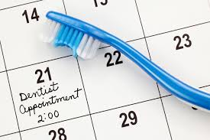
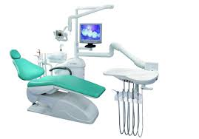
Healthy Montana Kids Plus and Medicaid Dental Program
Tips, Tricks and Updates
April 2015
Presented by: Jan Paulsen, Program Officer

Slide 2

Provider Rate change
During the 64th Legislative Session, an estimated 2% provider rate increase was approved. Check the website for a copy of the newest fee schedule, and the newest provider manual reflecting the rate increase and any program changes. This is likely to be implemented effective July1, 2015.
www.medicaidprovider.mt.gov click on ‘resources by provider type’’

Slide 3
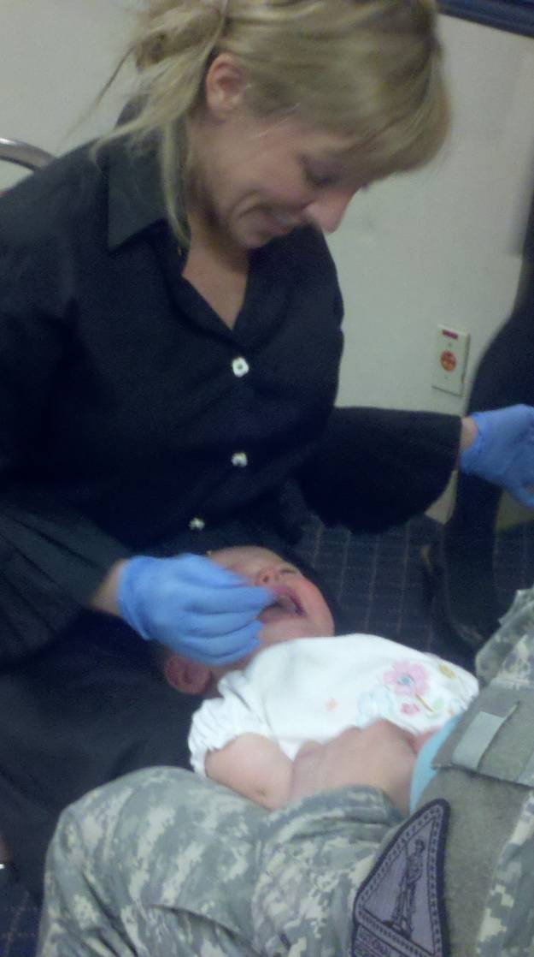
MT Medicaid supports a new practice standard: AbCd
Access to Baby and Child Dentistry- AbCd
First Birthday, First Dental appointment
Dentists must receive continuing education in early
pediatric dental techniques to qualify as an AbCd specialist.
This specialty endorsement will allow AbCd Dentists to be
reimbursed for the following procedures:
  D0145, Oral evaluation (age 0-2),
  D0425, Caries Susceptibility Test (age 0-2)
  D1310, Nutritional Counseling (age 0-5),
  D1330, Oral Hygiene Instruction (age 0-5).
Currently there are 185 Medicaid AbCd trained dentists

Slide 4
Frequently Asked Questions
Can I limit the numbers of Medicaid patients I see in my office? Yes, simply make a business decision as to how many Medicaid members your office can handle. Many offices do this.
Can I accept or reject them on a case by case basis? Yes, as long as you do not discriminate. When you sign-up as a Medicaid provider you agree not to discriminate on the grounds of race, creed, religion, color, sex, national origin, marital status, age or disability.
Will I be listed anywhere as a Medicaid provider? Yes, the department does maintain a list of participating providers on the Web Portal, Montana Access to Health. An updated list of dental providers who are currently accepting Medicaid patients is also on the Departments web site, www.medicaidprovider.mt.govand updated quarterly.

Slide 5
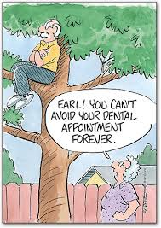
TOP 3 Frustrations
1. No Show/Broken appointments
Each office is encouraged to have a general office procedure for reminders.
All patients need to be treated the same in terms of reminders and no shows. Cannot bill patient.
There are a variety of ‘best practices’, find what works for your office.
Consistency is important.
No show, no procedure performed,
nothing to claim. Cannot bill patient.

Slide 6

2. Minimize Administrative Hassles
Use the ADA form dated 2012.
Attach special forms, such as Essential for Employment, Emergency Dental form or EOB for other insurance. Staple any form on top of the claim.
Document disability or the reason for
exceeding limits in box 35.
Include PA# in box #2, do not attach the
approval notice.
Consider filing electronically.
Follow-up e!SOR sooner than later.

Slide 7

3. Reimbursement too low?
File claims with your Usual and Customary fee.
Get paid for what you do, verify eligibility, check fee schedule, be aware of allowable procedures, limits, etc.
If prior authorization is required make sure you go through the process and put the # in box 2.

Slide 8

Other barriers identified
Limited availability of dental providers;
Lack of clear information for beneficiaries explaining their dental benefits;
Transportation (1-800-292-7114);
Cultural and language competency;
Need for consumer education about the benefits of dental care.

Slide 9

Verifying Client Eligibility
Fax Back: 800-714-0075
Automated Voice
Response (AVR):
800-714-0060
Web Portal: https://mtaccesstohealth.acs-shc.com/mt/secure/home.do
Xerox Provider Relations: 800-624-3958

Slide 10
Web sites:
Site Contents
Montana Access to Health
(aka Web Portal, requires login)
https://mtaccesstohealth.acs-shc.com/mt/secure/home.do
Check eligibility.
Claim Status.
Payment summary.
e! SOR.
Department Website
(open to the public)
www.medicaidprovider.mt.gov
Resources by Provider
Type (manuals, fee schedules,
notices, etc.).
Provider Information Page.
Claim Jumper newsletter.
Link to log onto to MT Access to
Health Web Portal.
Link to update provider file.
Client information, how to locate a
healthcare provider.

Slide 11

Montana Dental Rate Setting Process
The Department reimburses dental and denturist services on a fee for service basis. Reimbursement rates are established by multiplying a nationally recognized unit value for each procedure by the Department’s conversion factor.
Relative Values for Dentists (RVD) is an accurate and comprehensive relative value system. The relative values for each procedure are determined
by dental practitioner input.
6 Criteria are used to rate
each procedure.

Slide 12
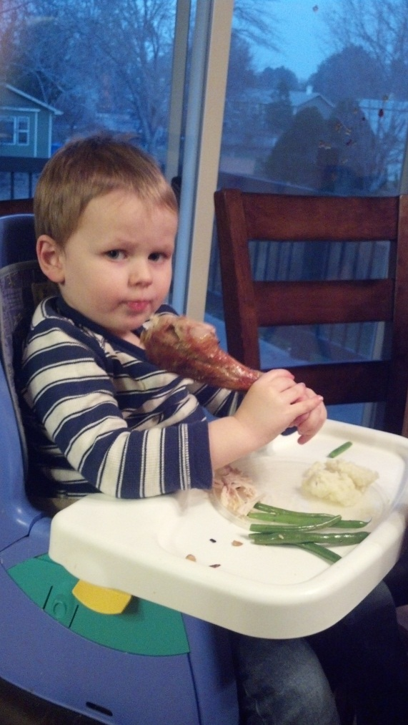
The six criteria used to rate a procedures value
1. Time
2. Skill
3. Risk to the patient
4. Risk to the dentist
(medico-legal)
5. Severity of the problems
(i.e., emergent, acute, chronic,
prophylactic)
6. Unique supplies not separately billable

Slide 13
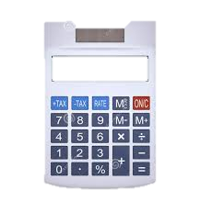
Dept. Calculation of Rate
Determine utilization of each procedure from previous year.
Multiply each procedure code’s utilization by its unit value based on the Relative Values for Dentists.
Obtain the upcoming year’s budget amount.
Total budgeted $ amount is divided by previous year’s utilization of all procedures.
The result determines the MT Medicaid Dental conversion factor (CF) = $32.53 for SFY14.
The rate for each procedure is determined by multiplying the unit value by the conversion factor.
Examples:
  D1110 has a unit value of 1.50 multiplied by the CF = $48.80
  D2140 has an assigned unit value of 2.0 times CF = $65.06.

Slide 14
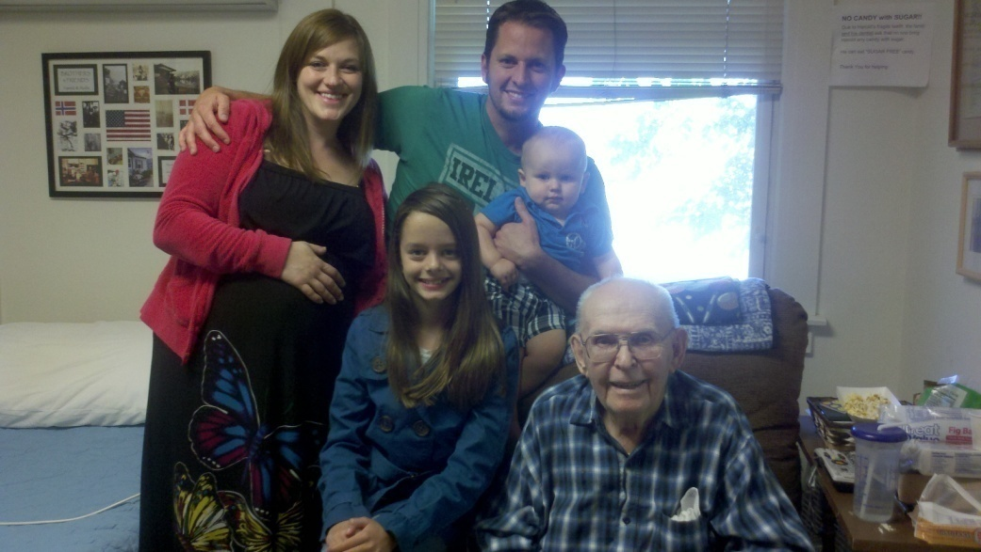
Who is eligible for Dental Services
Patients on FULL Medicaid
  Aged, Blind, Disabled, 20 yrs. and under and Pregnant woman.
Patients on BASIC Medicaid
IF:
They are approved under:
  Essential for Employment
  or
  Emergency Services.

Slide 15

What needs Special Processing
Check limits
  Diagnostics
  Radiographs
  Prophys and Fluoride
  Crowns
  Periodontics
  Dentures, full/partial
Prior Authorizing (PA)
  All Orthodontia
  Veneers
  Crowns: NO PA effec 8-1-12

Slide 16
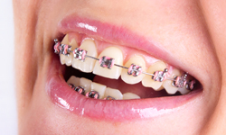
Orthodontia Services
Prior Authorization Process: HLD-Index, pano, ceph and photos.
Banding fee (D8050, D8060, D8070, D8080, and D8090,
Periodic visits (D8670), de-band and final retention (D8680).
Eligibility must be on-going, private pay agreement in place. TPL-Blanket Denial.

Slide 17
FORMS: www.medicaidprovider.mt.gov
ADA Dental Claim Form,
Prior Authorization box checked
Handicapping Labio-Lingual Deviations Form (HLD Index)
Revised 9/2013, added posterior impactions and anterior crossbite

Slide 18
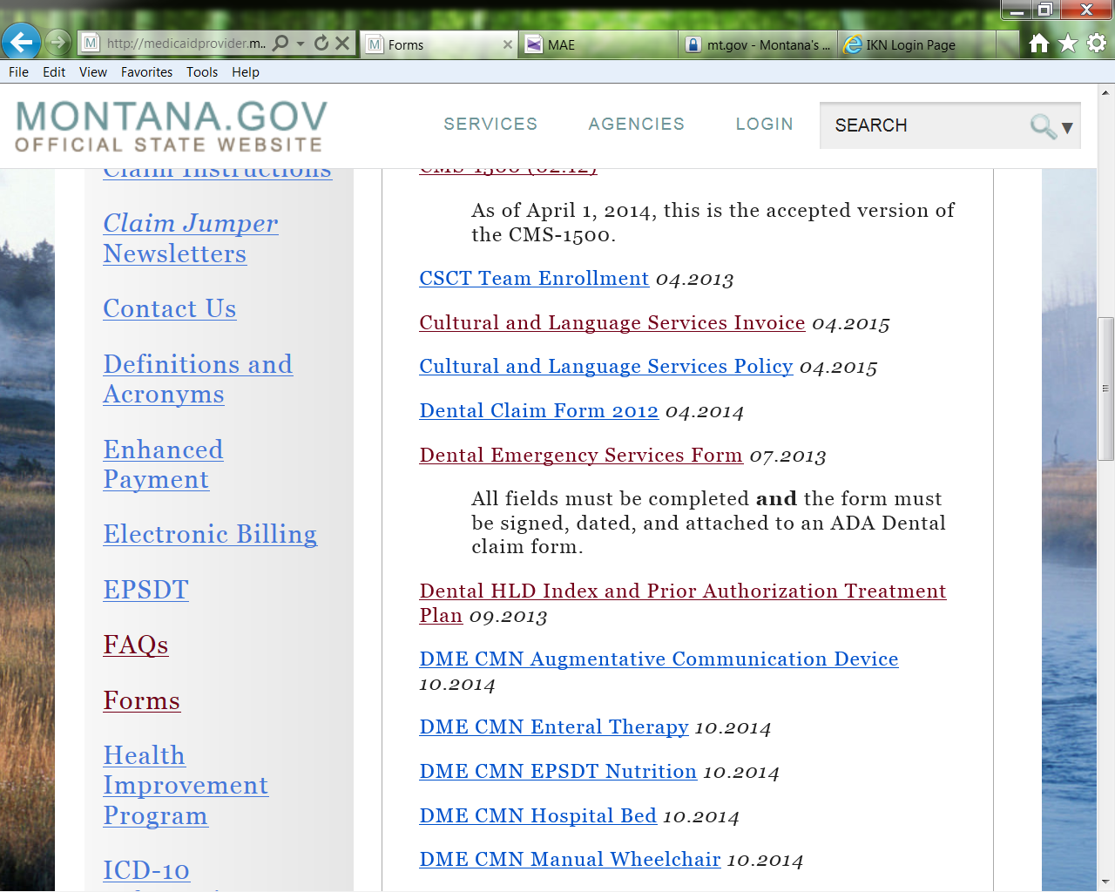
www.medicaidprovider.mt.gov
N New

Slide 19

Crowns for Adults
D2751
2 per calendar year per person
Second Molars:
#2-15-18-31= D2791
Effective 8-1-12, NO PA needed

Slide 20

Early and Periodic Screening, Diagnosis and Treatment - EPSDT
When a Medicaid-eligible child (20 and under) requires medically necessary services, those services may be covered under Medicaid even if they are not typically covered services or if periodic limits need to be waived.
Documentation of
Medical necessity is
VITAL.

Slide 21
Medical Necessity definition
ARM 37.79.102 (23) "Medically necessary" or "medically necessary covered services" means services and supplies which are necessary and appropriate for the diagnosis, prevention, or treatment of physical or mental conditions as described in this subchapter and that are not provided only as a convenience.

Slide 22
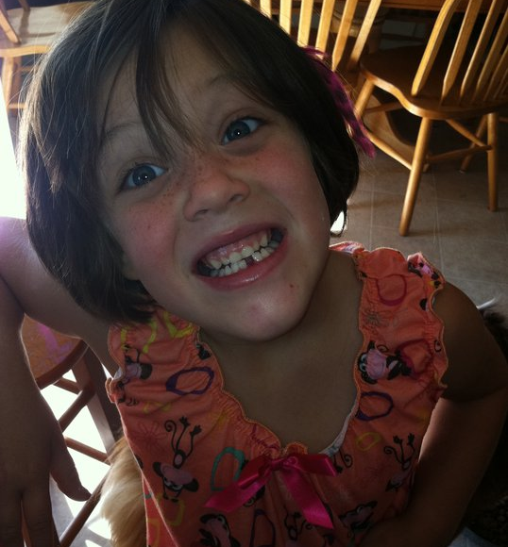
Medical Necessity:
Medicaid does not cover cosmetic dental services.
NEW 8-1-2011
Veneer’s require prior authorization (PA)
Provide a diagnosis that is requiring this treatment plan.
D2960
D2961
D2962

Slide 23
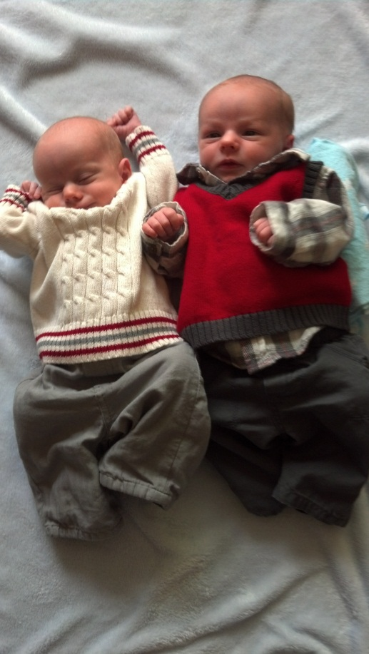
BE IN THE KNOW!
PA means prior authorization NOT
periapical.
What are the first two questions
JAN will ask you when you call?
1. Member ID (Use Medicaid ID not SS#)
2. Date of service.
Resources by Provider Type:
www.medicaidprovider.mt.gov
Multiple units.
Pay to dentist and Rendering dentist.

Slide 24
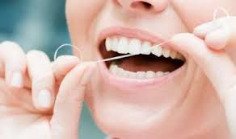
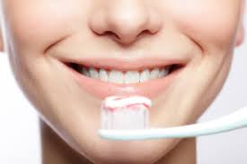

REVIEW OF What WAs New IN 2014
Caries risk assessment finding: Use like Diagnosis codes at the line level: D0601 Low risk, D0602 Moderate risk, D0603 High risk. No reimbursement.
ADA deleted D0363 three-dimensional cone beam, new code with Medicaid D0367, similar scope of service.
D2740 crown anterior AND posterior age 20 and younger.
‘By Report’ codes have gone away D2999, D4999, D5899, D6999, D7999. D9999 will be payable with PA only (for anesthesia travel).

Slide 25

New in 2015
Dental Advisory Committee (DAC)
General Dentist
Denturist
Pediatric Dentist
Orthodontist
Oral Surgeon
Dental Hygienist
MT Dental Association
DPHHS

Slide 26

Private Pay Agreement
The agreement to pay privately must be in writing and based upon definite and specific information given by the provider to the member prior to the services being delivered/performed indicating that the service will not be paid by Medicaid. This gives them the option to deny the service. The private pay agreement must be in writing per occasion. This does not include routine and general contracts signed by the member at the time of acceptance into the office. Providers can not pick and choose which codes to have members privately pay. If it is a covered service by Medicaid they must accept the fee in full. If it is not on the fee schedule it can be pre-agreed for private pay.
ARM 37.85.406 (11)(1)

Slide 27
Revised ADA Claim Form 2012
The ADA Dental Claim Form has been revised to incorporate key changes to the HIPAA standard electronic dental claim transaction. Some of the changes include the reporting of diagnosis codes and diagnosis code pointers, place of service codes, and other medical and dental coverage. It also includes a column for units of service.
Begin using the form now. Required 1/2015.

Slide 28

Record Keeping
The dental record must be:
Authentic
Legible
Objective
Clear on the disease condition that made the treatment necessary
#1 Rule of Documentation
If you didn’t write it, It didn’t happen!

Slide 29
NEW Claim System coming
Montana Health Care Programs will be supported by Health Enterprise Claim Payment system. This new claim payment system will be able to accept claims electronically; on-line or transmitted through your software.
Provider enrollment and payment will also be updated providing for a “Provider Inbox” to receive your important documents.
Letter generation to members, eligibility check, claim status, etc. will all be made more efficient.

Slide 30
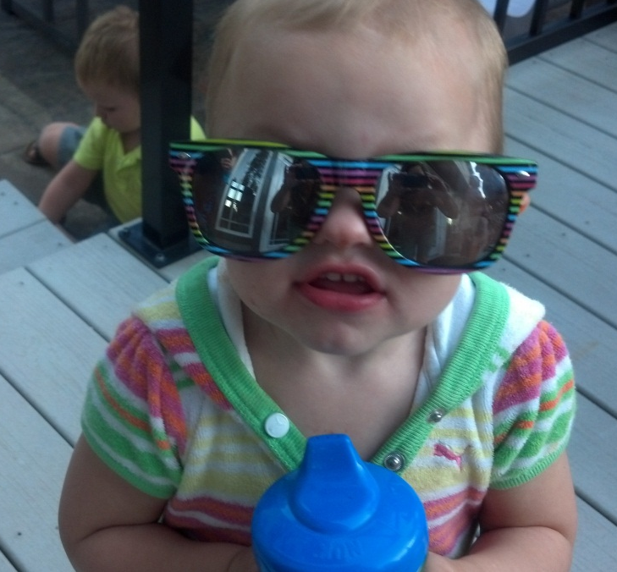
CHIPRA LEGISLATION
List of dental providers who are currently accepting Medicaid for under age 21 will be posted.
Updated quarterly, expect an e-mail!
www.insurekidsnow.gov
CMS/HRSA/IKN completes annual
survey to verify data.

Slide 31
Montana Statistics SFY14
405 Enrolled Dentists, Denturist and Hygienists.
Dental related expenditures SFY14: $26 million+
Served 42,410 recipients
Personal Transportation SFY13: 2.8 million+
Call center 1-800-292-7114

Slide 32

How we Communicate with your office
Notices from MMIS
www.medicaidprovider.mt.gov
  Provider Notices
  Fee Schedules
  Provider Manuals
  Remittance Advice
  Claim Jumper
  Web Portal https://mtaccesstohealth.acs-shc.com/mt/secure/home.do

Slide 33


AGAIN-Proceed with caution
Refer to the Provider Manual
There may be limits, per procedure, per tooth, per quadrant, anterior/posterior, or prior authorization requirements.
See the fee schedule and provider manual
on-line for current reimbursement rates.
Additional resources can be
found at: www.medicaidprovider.mt.gov
click on ‘resources by provider type’.
ACS Provider Relations:
1-800-624-3958

Slide 34

Thank you for your time!
I am a resource as well, feel free to contact me with any further questions or unique issues to discuss,
Jan Paulsen
Medicaid Dental Program Officer
PO Box 202951
Helena MT 59620-2951
jpaulsen@mt.gov
Phone: 406-444-3182
FAX: 406-444-1861

